Slide 1


St Mary’s Catholic Primary School
Prospectus
‘ This is our school, let peace dwell here’
Northwood Road,
Whitstable,
Kent CT5 2EY
01227 272692
office@st-marys-whitstable.kcsp.org.uk
www.st-marys-whitstable.kent.sch.uk

Slide 2

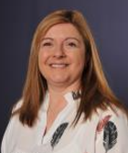

Welcome
We are delighted to welcome you to St Mary’s Catholic Primary School. We are a school of around 300 children situated on the beautiful Kent coast. We are part of the Kent Catholic Schools Partnership who are an ever-growing multi-academy trust.
We understand that starting school is a momentous occasion and that choosing a school for your child is a huge decision. We want to show you all of the things that we can offer your child and what makes St Mary’s like a ‘family’.
Our school is a learning community where pupils, staff, families and governors work in close partnership. Everyone is welcomed and valued.
We are committed to fostering high expectations and developing the full potential of each individual child, so that they become life-long learners. We offer a broad, balanced curriculum delivered by a team of dedicated, caring and professional staff.
Each child is encouraged and supported to build on their previous best and to live out our mission statement. We aim to create opportunities to develop independence, confidence and understanding; recognising that everyone has their own unique gifts and talents bestowed on them by God.
We warmly invite you to visit our school and very much look forward to meeting you.
Mrs Michele Blunt
Headteacher

Slide 3
Safeguarding Statement
At St Mary’s Catholic Primary School, the safety and wellbeing of our pupils is our highest priority. We are fully committed to safeguarding and promoting the welfare of all children in our care.
We expect all staff, governors, volunteers and visitors to share this commitment. Our robust safeguarding policies and procedures ensure that pupils are safe, supported and able to thrive in a nurturing environment.
Our safeguarding approach includes:
Comprehensive training for all staff and governors to recognise and respond to safeguarding concerns
Rigorous recruitment checks for all staff and volunteers
Clear procedures for identifying and reporting concerns
A dedicated safeguarding team, led by our Designated Safeguarding Lead (DSL)
Strong partnerships with parents, carers and external agencies to protect children and support families
Promoting a culture where children feel safe, listened to, respected and valued
All concerns are dealt with promptly and confidentially.
We encourage parents and carers to speak to us if they need support or have any concerns.
Our full safeguarding and child protection policy is a
available on our school website or on request from the school office.
Together, we ensure that St Mary’s Catholic Primary School is a safe and welcoming place for every child to learn and grow.

Slide 4
Our Vision
We celebrate, respect and value everyone at our school as a unique gift from God.
We strive to ensure that our pupils have the opportunity to become the best version of themselves as a young person.
We aim to achieve this by being a centre of learning excellence, inspired and led by the teachings of Jesus Christ.
Our Mission Statement
Love of Learning,
Love of One Another
Love of the World,
Love of God.

Slide 5
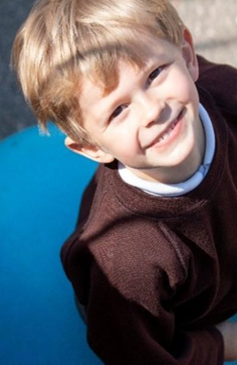
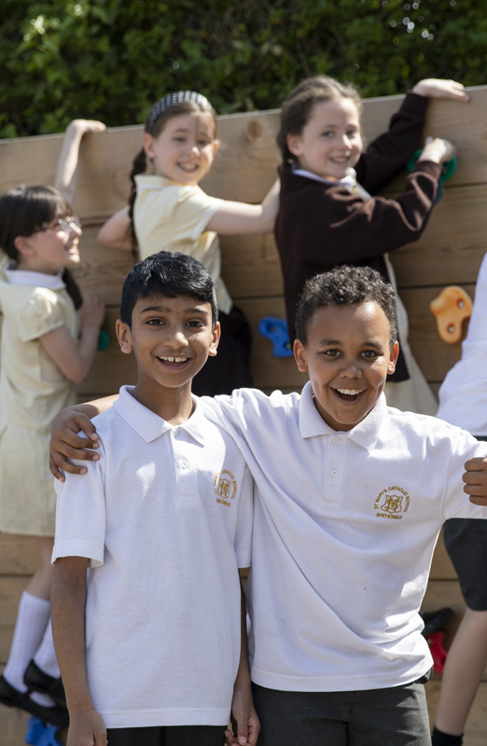
Our Values
JOY
Through Jesus’ example, our children know and experience the joy of coming to our school. We celebrate the achievements and contributions of every learner by ensuring that we support them equitably. Through an imaginative and creative delivery of the National Curriculum, we motivate and inspire our children to be active, confident, curious and caring learners.
COMMUNITY
We are a strong school family who love and care for each other, supporting everyone throughout our life journey. We instil in our children a sense of belonging to our school, our parish and our local area. As we develop in our children a set of transferrable skills for the future, they begin to understand the wider, more diverse world; our planet and their responsibility to become loving, caring and independent citizens.

Slide 6
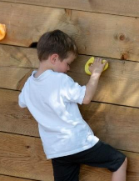
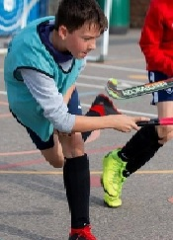
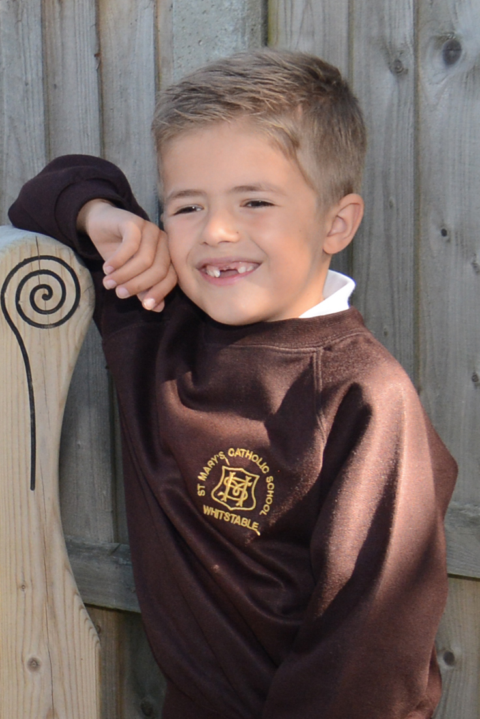
COURAGE
Through our Gospel values and a rich and balanced curriculum, we will encourage our children to stand up for what they believe in. St Mary’s children will learn from all of the successes and mistakes they make to help them strive for a better future. At all times we will challenge our children to independently take risks to achieve the very best they can.
EXCELLENCE
Through our exciting and challenging curriculum and by building on children’s prior and home learning, we will make sure every child achieves highly from their own individual starting point, whilst developing a life-long love of and commitment to learning.
HONESTY
We are honest and truthful to ourselves and God. Through the teachings of Jesus Christ alongside the British values of mutual respect, tolerance, liberty, democracy and the rule of law, we aim to nurture our children’s personal development, encouraging them to lead responsible, safe and healthy lives.

Slide 7
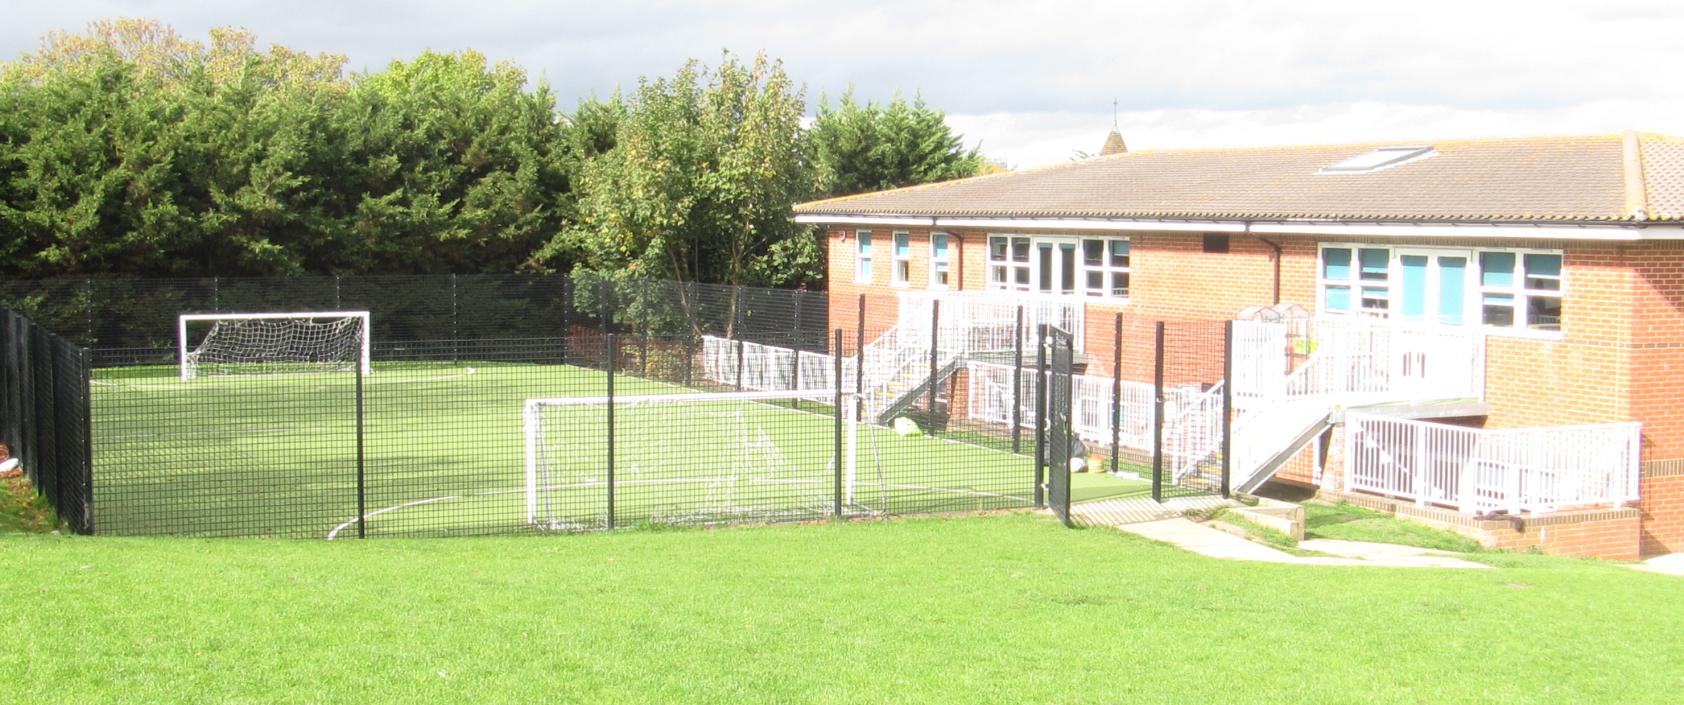
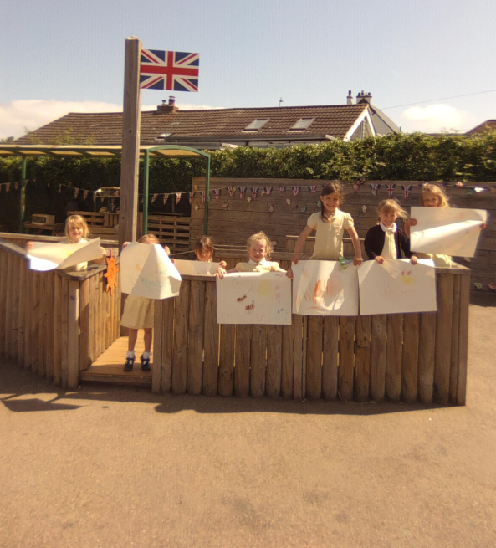
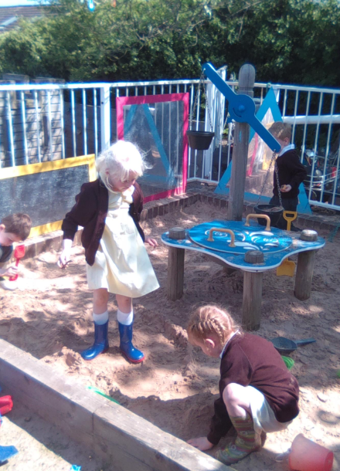
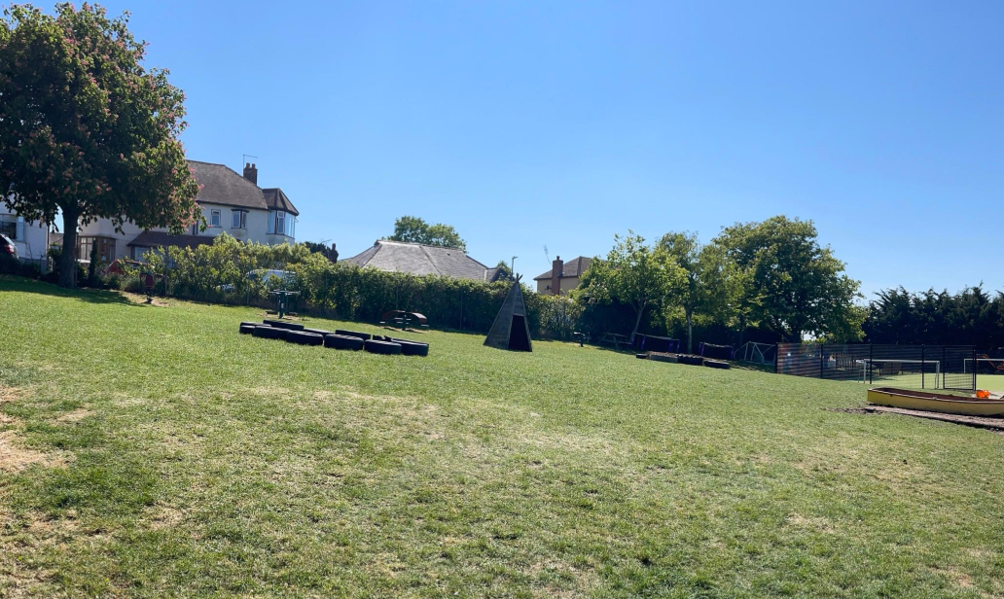
Our Site
At St Mary’s, we are proud to offer a vibrant and well-equipped learning environment for our pupils.
Our school features twelve classrooms, providing dedicated spaces for each year group. The school hall serves as the heart of our community, hosting assemblies, PE lessons, whole group activities, and lunchtime.
EYFS and Key Stage 1 classrooms are thoughtfully positioned around our main playground, each with access to their own secure outdoor play areas, supporting active and creative learning. We also have a well-stocked library, a computer suite to enhance digital skills, and a dedicated music room.
Our outdoor space includes a large school field, an all-weather pitch, a spacious playground, and a thriving school garden — ensuring plenty of opportunities for learning and play in the fresh air.

Slide 8

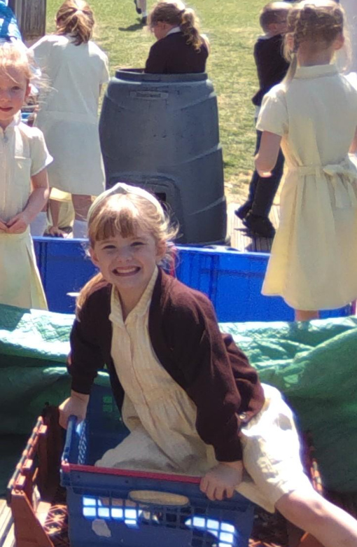
Opal Play
At St Mary’s Catholic Primary School, we are proud to be an OPAL (Outdoor Play and Learning) school. Through our OPAL programme, we are dedicated to enhancing playtimes so that every child has opportunities to explore, create, and build resilience..
Our children enjoy making full use of our outdoor spaces in all weathers, engaging in imaginative and adventurous play that supports their wellbeing and development. By prioritising high-quality outdoor play, we help our pupils grow in confidence, social skills, and creativity, making playtime a valuable part of their school experience

Slide 9
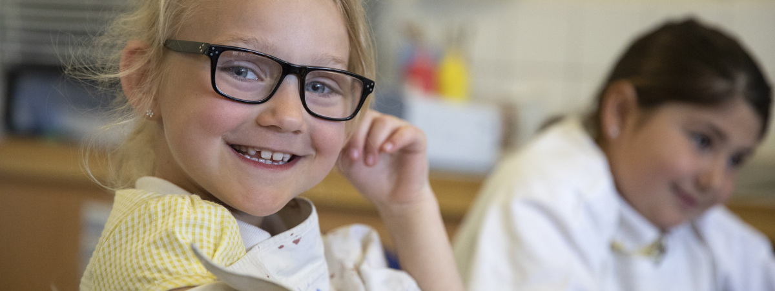
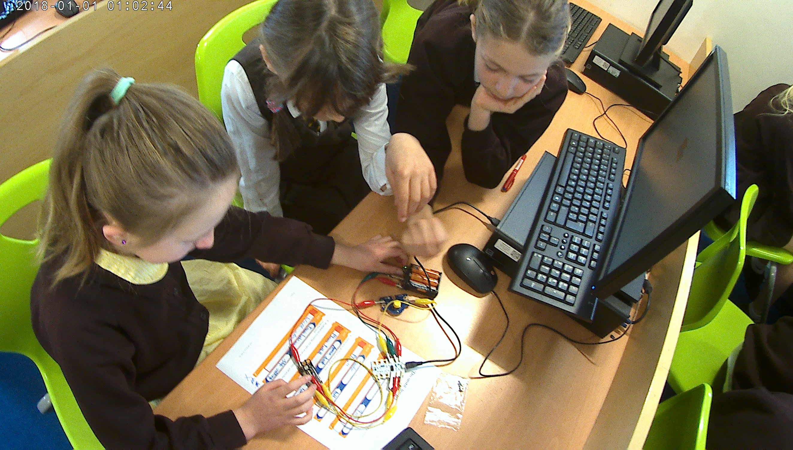
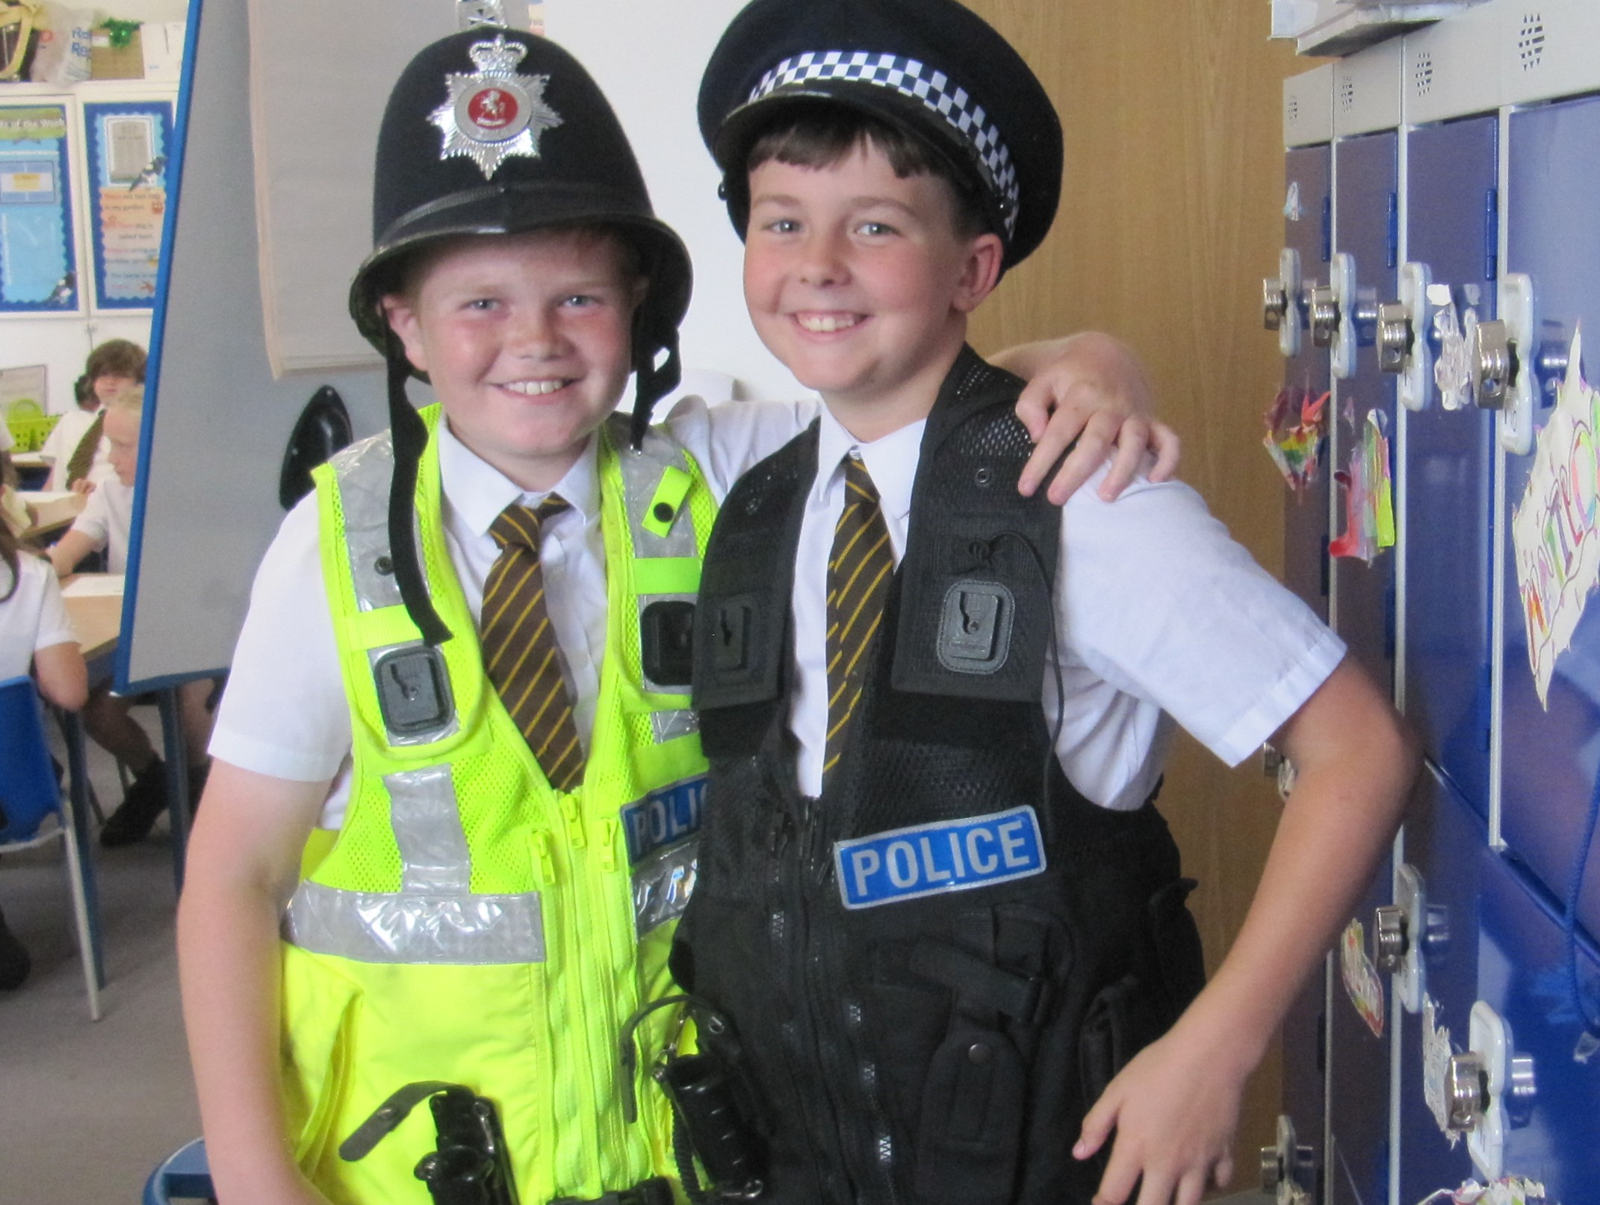
Learning at St Mary’s
At St Mary’s, we believe that an ambitious, exciting curriculum is the key to transforming children’s lives and developing them into lifelong learners. Fostering children’s curiosity will give them a desire to learn that both enriches them and equips them with the skills, values and attitudes needed to find their place in modern
Britain and the wider world.
Our curriculum has been designed with great care by our teachers collectively in order that there are opportunities to acquire deep and meaningful knowledge and explore a broad range of skills to apply this knowledge, thus preparing children for life beyond school.

Slide 10
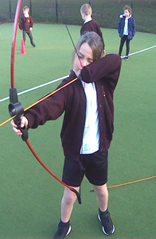
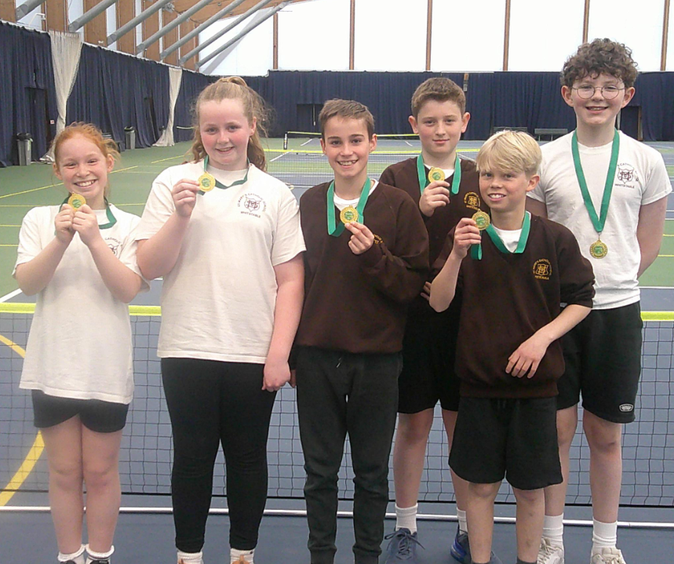
Children’s learning is driven by high expectations so that they can succeed academically. However, the curriculum is also our most important tool in developing children more broadly, supporting their creative and sporting aspirations and enabling children to grow up spiritually in the context of our Catholic culture. We help children to build a moral foundation through the explicit teaching of Catholic values that are compatible with modern British values, in order that they develop qualities such as respect, compassion, tolerance and forgiveness.
SPORTS
We are fortunate enough at St Mary’s to have Team Theme sports coaches teaching weekly outdoor PE lessons with all of our classes. They also run before and after-school sports clubs throughout the year for both infants and juniors. At St Mary’s our children take part in numerous sporting competitions, including football, hockey and netball.

Slide 11
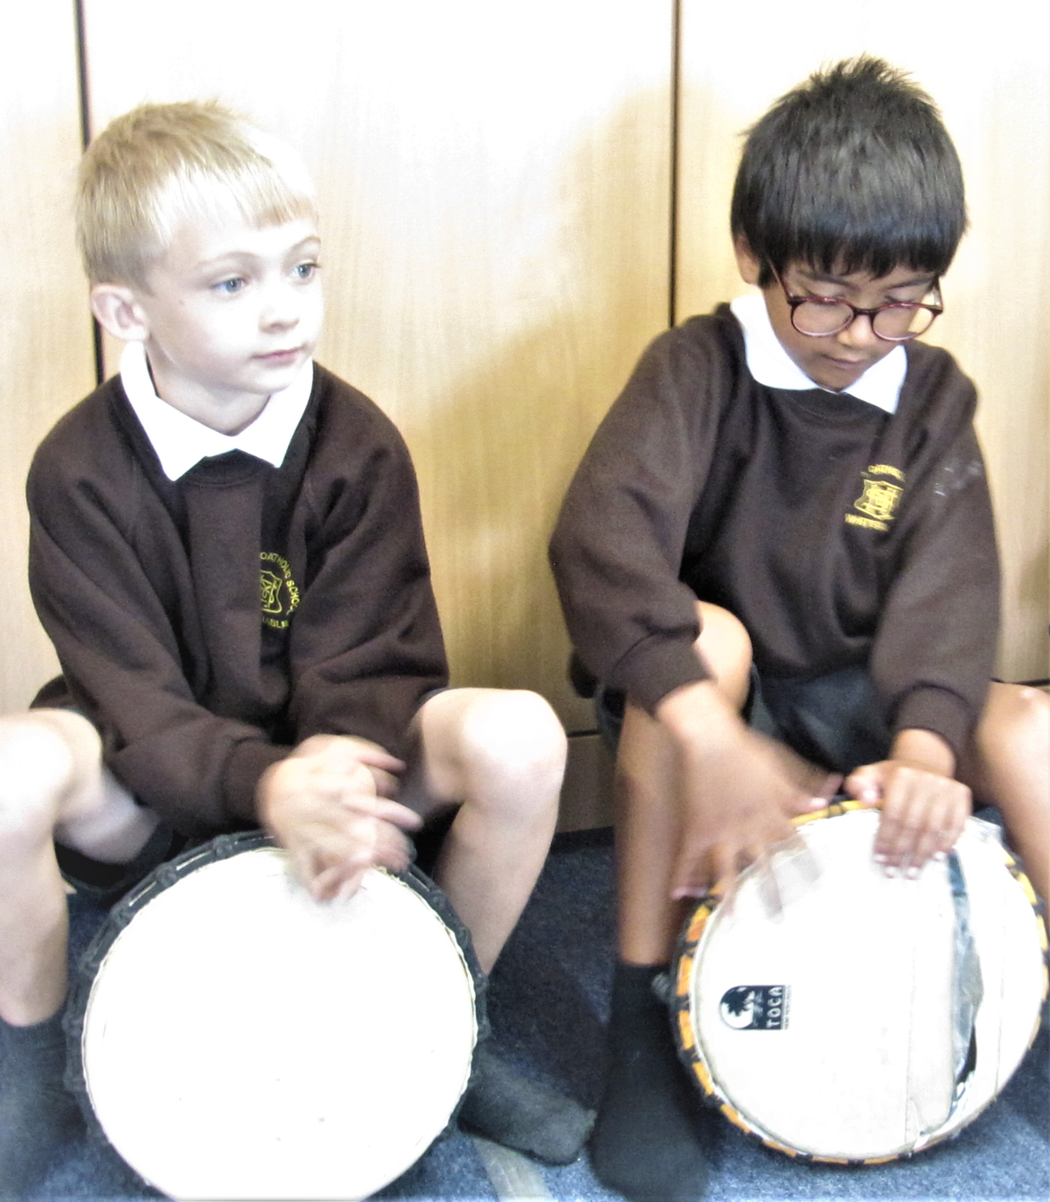
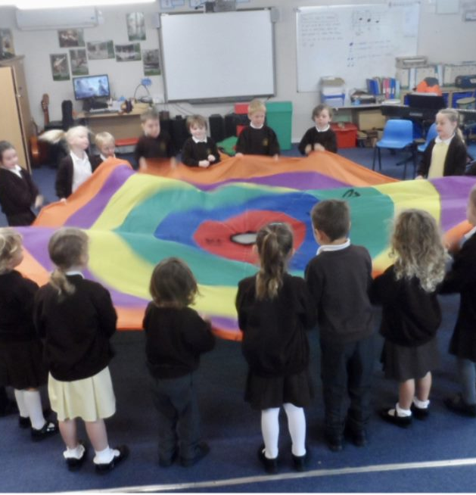
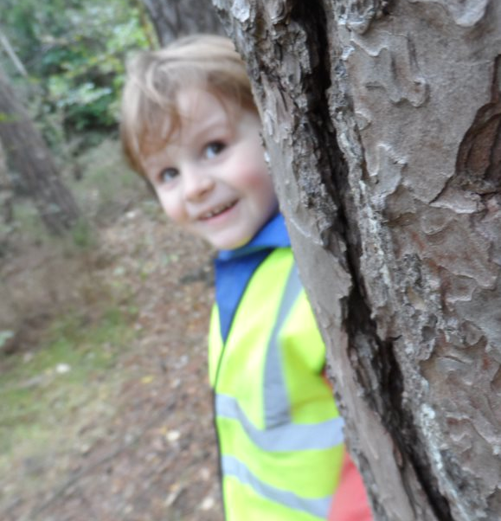
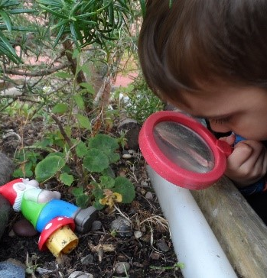
MUSIC
Music is a very important part of our curriculum. All children learn to play an instrument on their journey through our school. For those who would like to have additional instrumental lessons, at St Mary’s they will have the opportunity to learn to play the recorder, piano, violin, ukelele, guitar or drums.
OUTDOOR LEARNING
At St Mary’s, we believe that outdoor learning is an essential component of a well-rounded education. Through outdoor activities, children engage in hands-on experiences that enhance their understanding of science, develop their problem-solving skills, and foster a love for nature. Whether it's investigating local wildlife, participating in team-building exercises, or simply enjoying creative play in the fresh air, outdoor learning is woven into our curriculum to ensure that each child benefits from the myriad of advantages it offers. By blending classroom learning with the richness of the outdoors, we help our students build confidence, resilience, and a lifelong appreciation for the environment

Slide 12
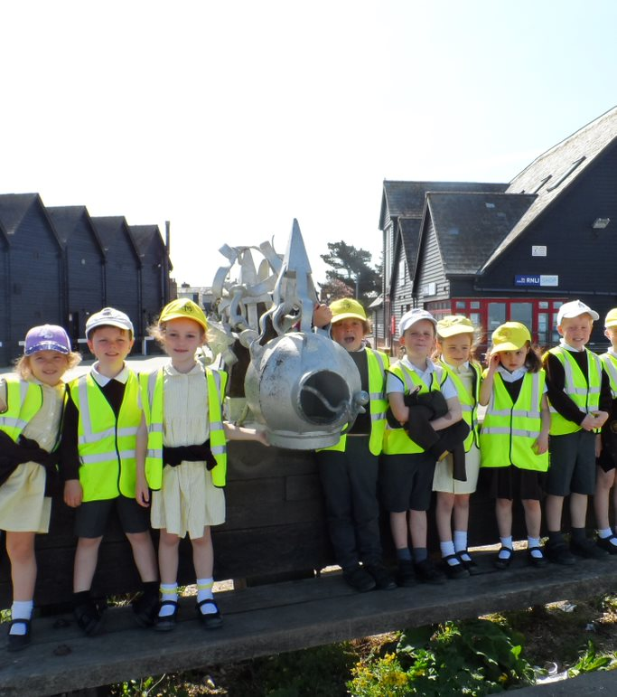
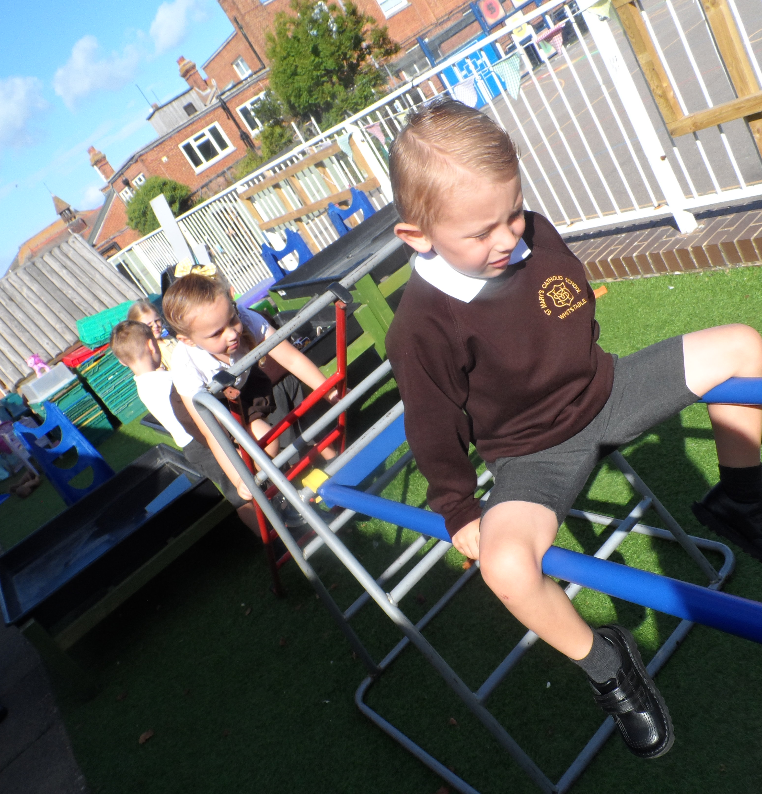
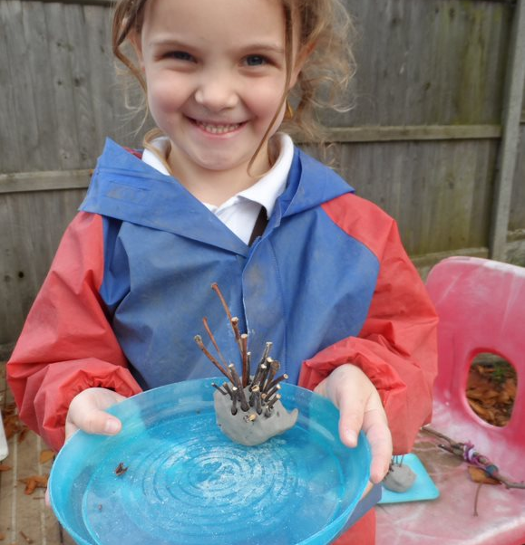
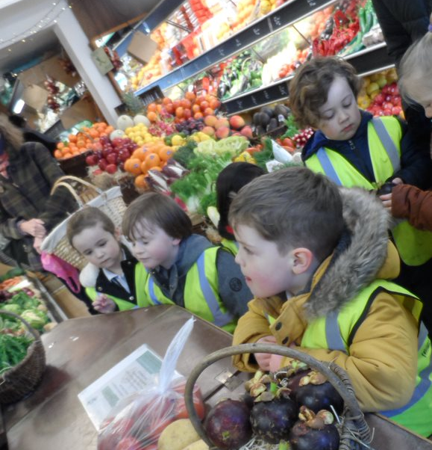
Early Years Foundation Stage
Our Early Years setting is a bright, vibrant introduction to St Mary’s, helping children develop a love of learning and a sense of curiosity. Children are encouraged to be independent and explore a wide range of resources and activities. The indoor and outdoor areas are exciting, stimulating environments, full of opportunities to play and learn. Our children regularly go out into the local community, for example the harbour and shops, to enhance their learning further.
In partnership with parents, we develop children’s learning and skills through following their interests and allowing children the freedom to investigate the world around them. This approach, along with explicit teaching of phonics and other basic skills, leads to happy, successful children in the Early Years! Adults use ongoing assessments to make sure that we meet all the children’s needs. Assessment information is used to provide children with activities that develop their learning and are challenging and engaging.

Slide 13

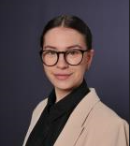
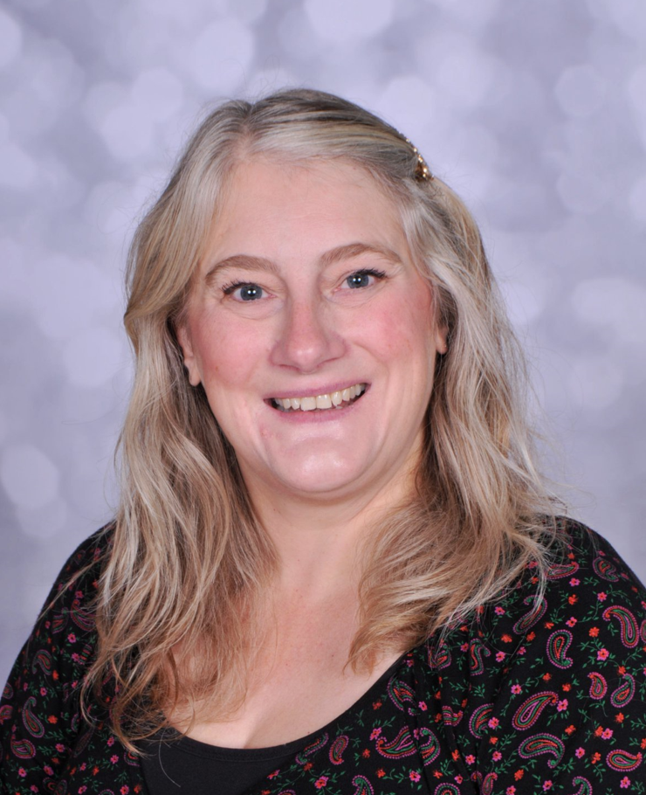

Wellbeing
Our staff at St Mary’s are committed to supporting the wellbeing of all of our pupils. There is a strong emphasis on looking after children’s personal and emotional needs. Our Welfare Officer, Miss Simpson, greets the children every morning at the school gate and runs group and individual sessions with children throughout each day.
We recognise that during their time with us, some children may need extra help and support for a wide variety of reasons and for different periods of time. The staff and governors at St Mary’s are committed to the integration of children with additional needs. All children within our school are valued as individuals and Mrs Clark, our SENCO, works in partnership with parents and staff to ensure that all children experience success, achieve across the curriculum and reach their full potential.

Slide 14
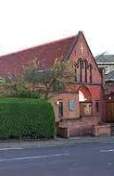
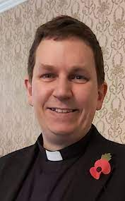
Our Links with the Church
St Mary’s School enjoys close links with our Parish, Our Lady Immaculate, and the neighbouring Parish of Our Lady of the Sacred Heart in Herne Bay.
Our Parish priest, Canon Philip Glandfield, supports us through the celebration of Mass and Liturgical Services. He plays an active role within our school community, enriching the curriculum and attending events throughout the year.

Slide 15
What parents say about our school…
‘The school integrates the older children and the younger children well and encourages kindness and compassion.’
‘Pastoral care is excellent.’
‘The school creates a happy and safe environment for the children. They are always making improvements for the children’s learning experiences.’
‘Makes you feel party of a community.’
‘I think St Mary's is a lovely school, providing a strong foundation for the children's further education in the future.’
‘The school nurtures each child as an individual, whilst supporting inclusivity, teaching my child to be part of a community and all that this represents. The school has a lovely, friendly, family feel.’

Slide 16
WRAP-AROUND CARE
At St Mary’s, we have a Breakfast and After-school Club run by Kindergarten Kids. This is open to children in all year groups.
All food supplied is healthy and nutritious and is adapted to meet dietary requirements.
SESSION 1 - 07:30 UNTIL SCHOOL COMMENCES
SESSION 2 - END OF SCHOOL DAY UNTIL 18:00
To enquire about a place, please contact Kindergarten Kids:
Head Office : 01227 772200
Mobile: 07514 819512
JOINING OUR SCHOOL
We hold a number of open days to give parents the opportunity to come and look at our wonderful school. Please see our website for details of these:
https://www.st-marys-whitstable.kent.sch.uk/Open-Days-Events-and-Tours/
To book a space for the open days and tours, please contact our school office on 01227 272692.
To apply for a place at St Mary’s parents will need to complete Kent County Council’s admission form. If your child is baptised, you should also complete our supplementary form on our school website:
https://www.st-marys-whitstable.kent.sch.uk/Our-Admissions-Process/

